Slide 1




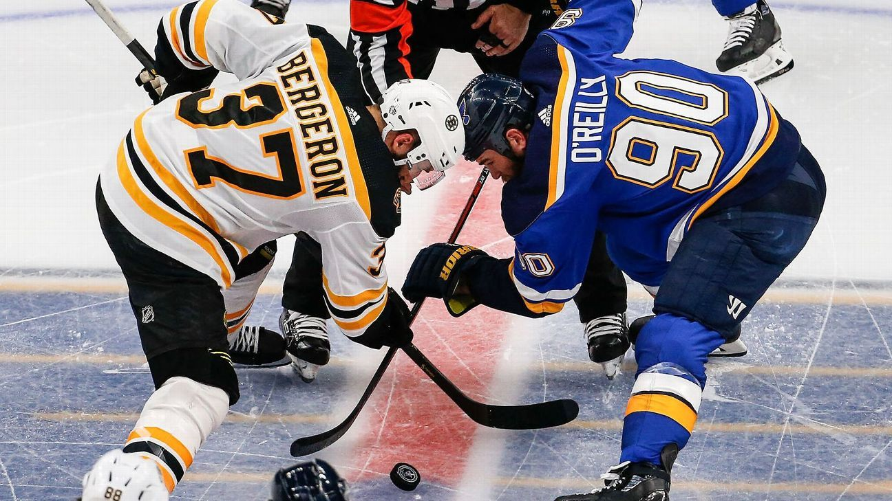
Puck Predictions: Modelling Ice Hockey Games
Ashley Hatch’s Capstone Project

Slide 2





Agenda
Introduction to ice hockey and predictions
MoneyPuck and Power Rankings
Simple and Advanced models – how they work
Demo time!
Model evaluation
Strengths, limitations and conclusion

Slide 3


How does the National Hockey League work?
Extremely fast-paced and high intensity sport
Two teams of ≈20 players, but only 5 skaters + 1 goaltender on ice at once
Players aim to skate the puck into the offensive zone and shoot it past the goaltender to score
Players play in shifts of 40-60 seconds before being substituted without play stopping
Ties are broken by 5 minutes of 3-on-3 overtime followed by a penalty shootout

Slide 4


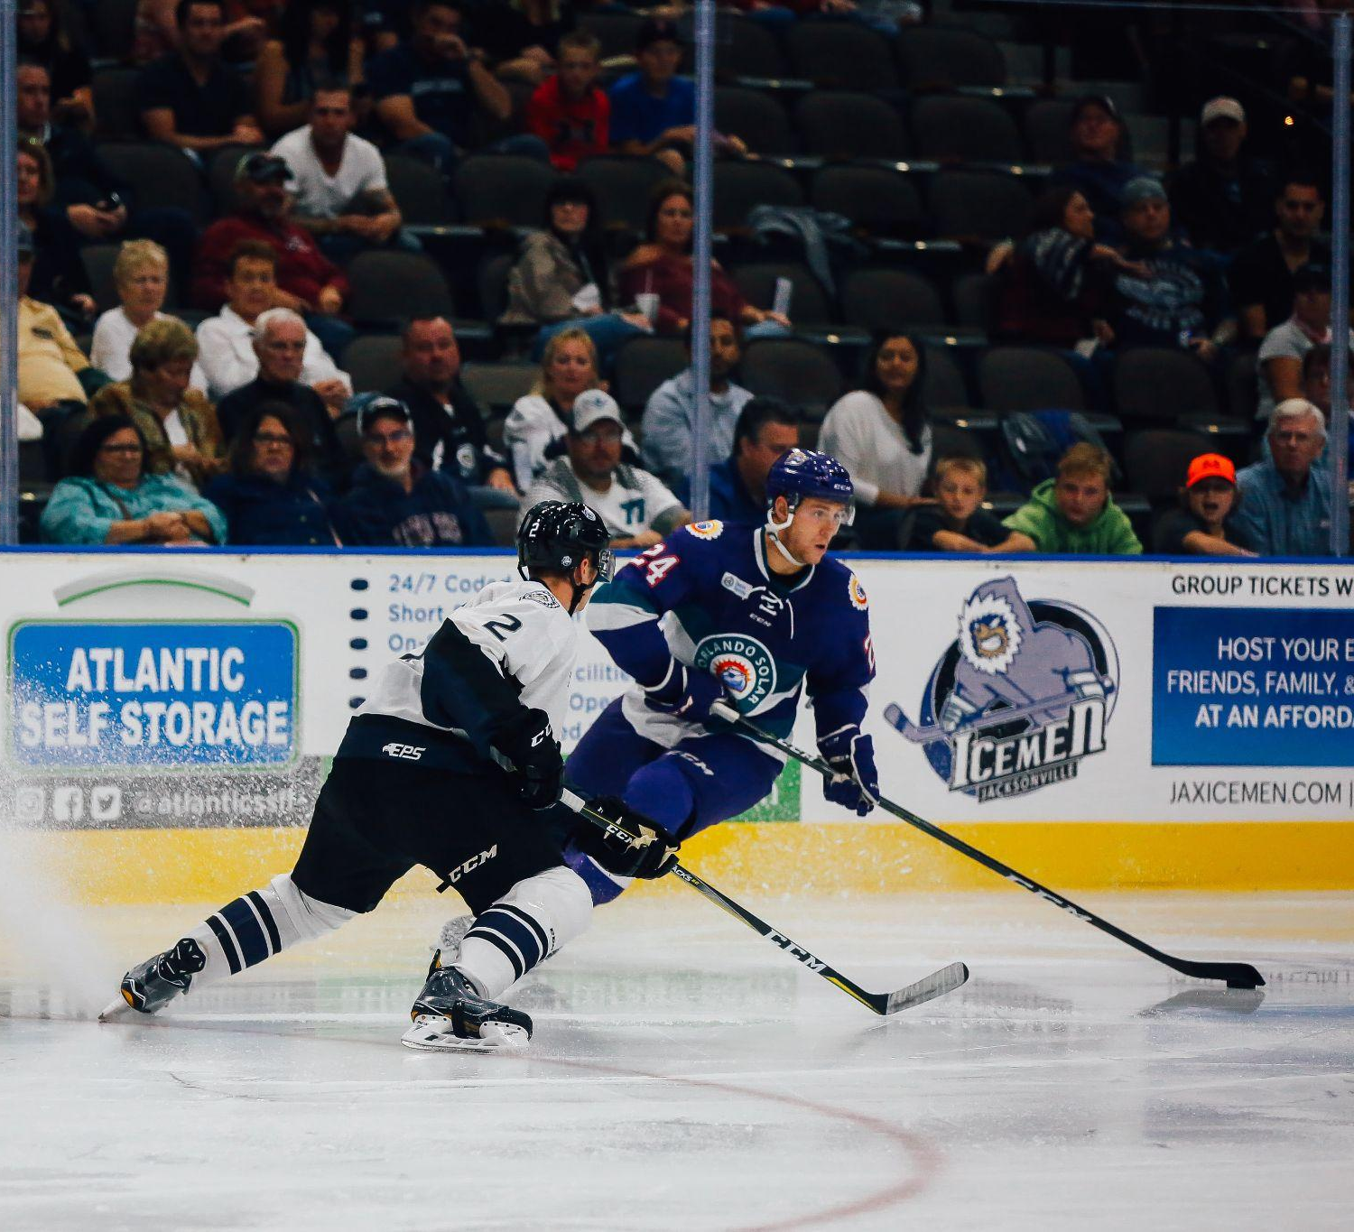
Why Make Predictions?
Team and player performance analysis
Entertainment and engagement
Introduction to data analysis
Informs commercial and media outlets
Notes:
Team and performance analysis – helps both players and coaches see which metrics matter, including important context like back-to-back games and home ice advantage, and which teams are performing well in different aspects of the game.

Slide 5

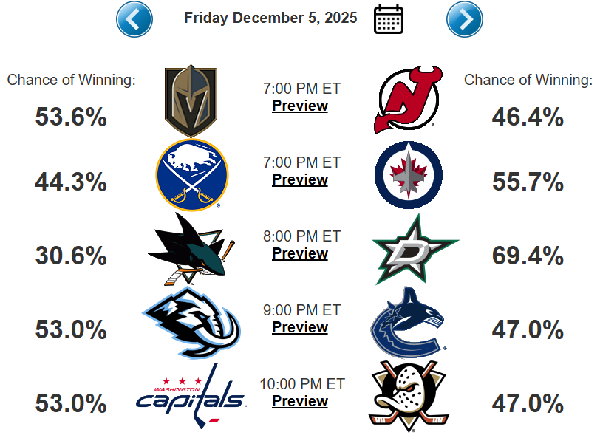
MoneyPuck
Website dedicated to predicting likelihood of each team winning upcoming matches
Uses three main components to inform its predictive models
  Ability to win
  Scoring chances
  Goaltending
Also accounts for home ice advantage, games on back-to-back days and injuries
Simulates the season 100,000 times

Slide 6
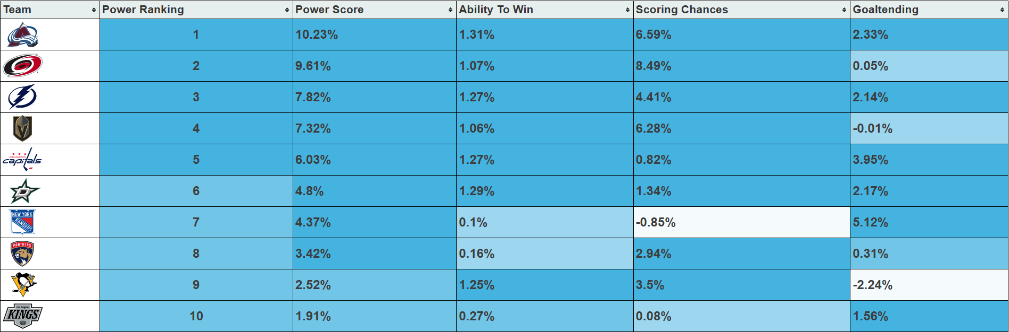
Power Rankings
Power Score = how much better a team is than average
  E.g. 10% power score = 10% better than the average team

Slide 7


My Objective
01
Gather the Data
02
Model the Data
03
Generate Predictions
04
Evaluate Predictions

Slide 8

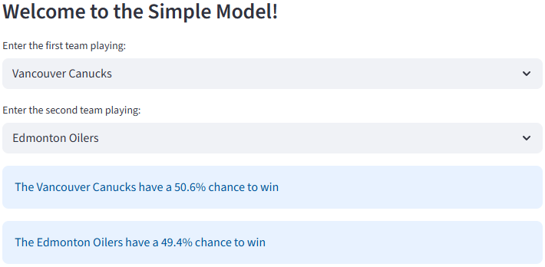

Simple Model
Uses data from 2025-2026 season (so far!)
Calculates likelihood of either team winning an upcoming game based on difference between their power scores
Limitations:
Does not account for home/away teams, back-to-back games, takes average goaltender performance

Slide 9
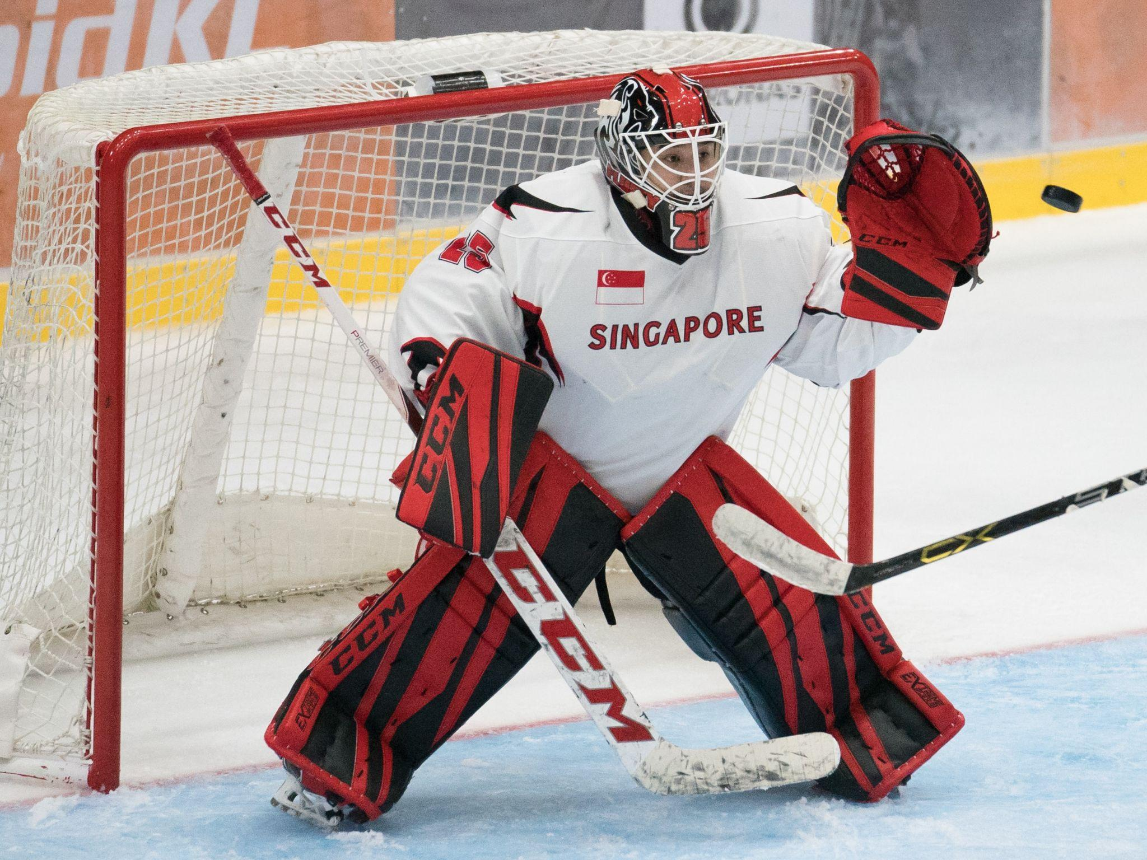
Advanced Model
Uses same data as simple model
Extended to allow for user to specify which team is home/away, which goaltender is playing, and whether either team played on the previous day
According to MoneyPuck:
  Home teams win ≈54% of games
  Playing back-to-back games when your opponent has had rest decreases win rate by ≈4%
  Model’s increased depth should improve prediction accuracy

Slide 10
Demo Time!

Slide 11
Evaluation – How did the Models do?
Tested on 30 real games from Monday 1st December to Thursday 4th December
MoneyPuck treated as baseline to drive comparisons
  Simple model agreed with MoneyPuck on 19/30 games
  Advanced model agreed with MoneyPuck on 21/30 games
    Both models significantly more conservative than MoneyPuck
Notes:
Since MoneyPuck inspired whole project and arguably has best reliability, used as baseline to compare my models against

Slide 12
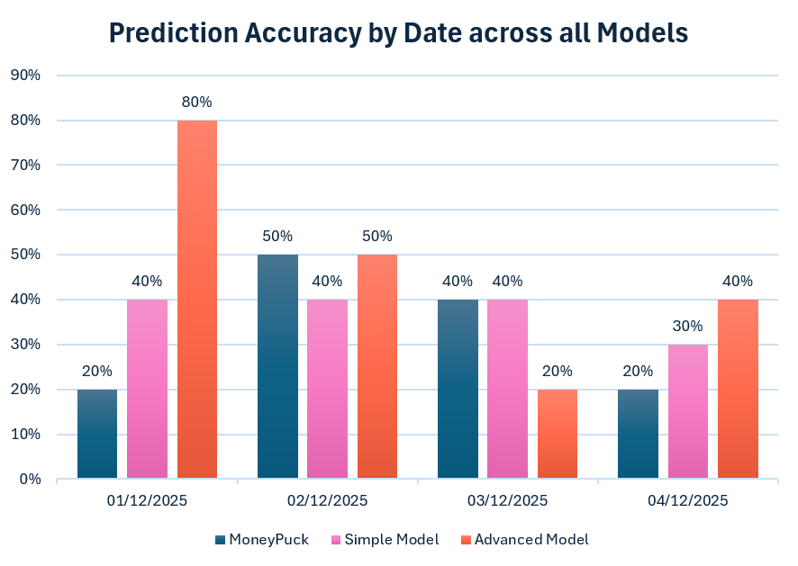
Evaluation – How did the Models do?
Model Accuracies over 30 games
MoneyPuck: 33.3% accuracy
Simple model: 36.7% accuracy
Advanced model: 46.7% accuracy

Slide 13
Strengths
Both simple model and advanced model exceeded MoneyPuck in test phase
Easy to use interface
Simple model requires limited data to exceed MoneyPuck
Easy to update with new data
Guided by MoneyPuck’s tried and tested formula

Slide 14
Future Directions
Develop model to account for player injuries
Automate the model to predict the upcoming season
Allow for multiple games to be input at once
    Increase amount of test data

Slide 15
Conclusion
Created two models to predict NHL games using win percentage, scoring chances and goaltending
Advanced model outperformed MoneyPuck and predicted at 46.7% accuracy overall
Developed an app to host the model
Could be used to inform commercial and media outlets, boost fan engagement and act as a stepping stone from an interest in ice hockey into data

Slide 16

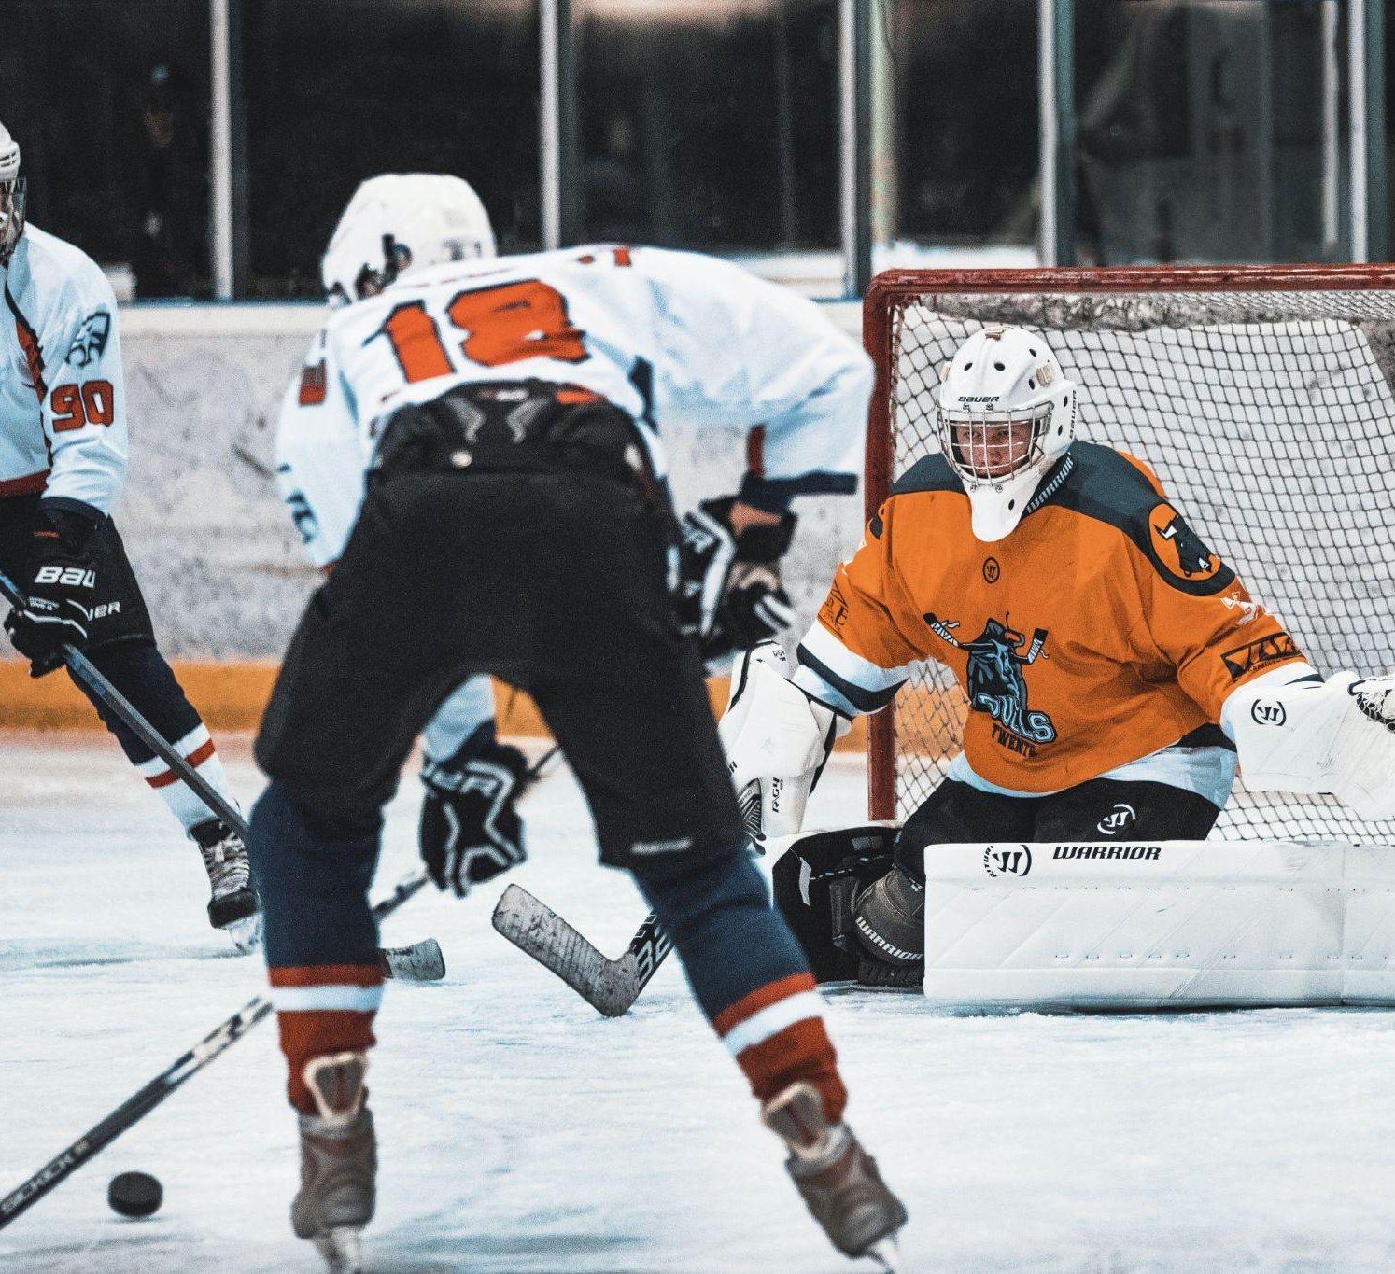
Thank You for Listening!
Any questions?

